Slide 1
DIGICAP SOLUTION
Presented by Group six:
Glorious Vuyanzi
Dickens Odera
Jeremiah Masinde
Fridah Kanario
Caroline Cherotich
Rex Mudanya

Slide 2
Challenge
The DHIS system does not capture essential commodities but captures others. Reports are extracted manually from 160 facilities; There is also need to add it as a dataset in the DHIS-2.

Slide 3
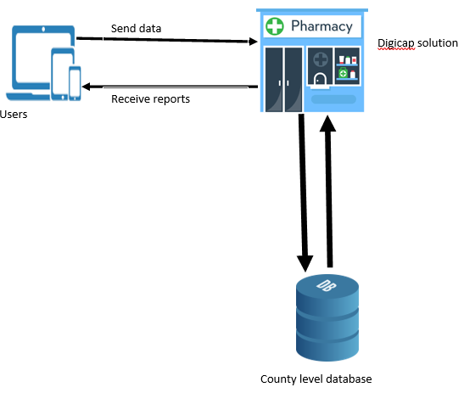
Level zero: context diagram

Slide 4
Level 1
user
Stock distribution
Stock consumed
Stock received
Stock transferred
DB
Reports

Slide 5
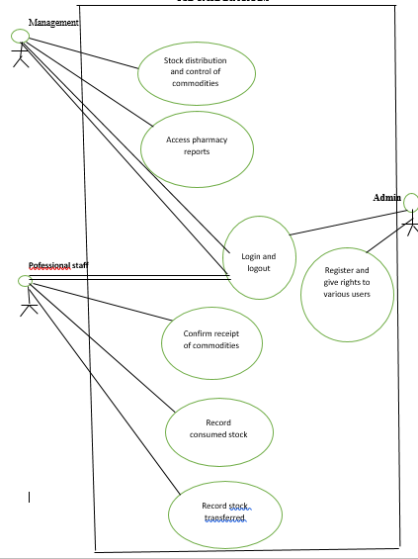
Use case diagram

Slide 6
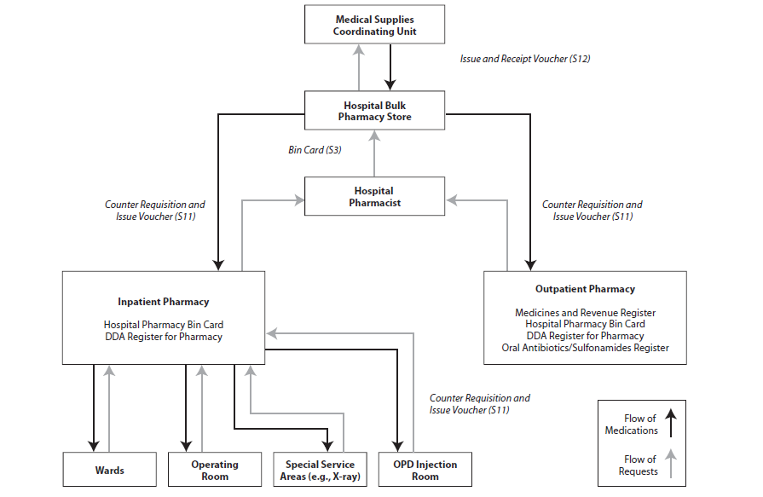
Architectural design

